Slide 1
Value at Risk and Expected Shortfall
Chapter 20

Slide 2
The Question Being Asked in VaR
“What loss level is such that we are X% confident it will not be exceeded in N business days?”

Slide 3
VaR and Regulatory Capital
Regulators have traditionally based the capital they require banks to keep on VaR
For market risk they use a 10-day time horizon and a 99% confidence level
For credit risk they use a 99.9% confidence level and a 1 year time horizon

Slide 4
VaR vs. Expected Shortfall
(See Figures 20.1 and 20.2, page 430)
VaR is the loss level that will not be exceeded with a specified probability
Expected shortfall (ES) is the expected loss given that the loss is greater than the VaR level
For market risk bank regulators are switching from VaR with a 99% confidence to ES with a 97.5% confidence

Slide 5
Advantages of VaR
It captures an important aspect of risk
in a single number
It is easy to understand
It asks the simple question: “How bad can things get?”
ES answers the question: “If things do get bad, just how bad will they be”

Slide 6
Historical Simulation
Create a database of the daily movements in all market variables.
The first simulation trial assumes that the percentage changes in all market variables are as on the first day
The second simulation trial assumes that the percentage changes in all market variables are as on the second day
and so on

Slide 7
Historical Simulation continued
Suppose we use 501 days of historical data (Day 0 to Day 500)
Let v_{i} be the value of a market variable on day i
There are 500 simulation trials
The ith trial assumes that the value of the market variable tomorrow is

Slide 8
Historical Simulation continued
The portfolio’s value tomorrow is calculated for each simulation trial
The loss between today and tomorrow is then calculated for each trial (gains are negative losses)
The losses are ranked and the one-day 99% VaR is set equal to the 5th worst loss
99% ES is the average of the five worst losses

Slide 9
Example : Calculation of 1-day, 99% VaR and ES for a Portfolio on Sept 25, 2008 (Table 20.1, page 432)
Index | Value ($000s)
DJIA | 4,000
FTSE 100 | 3,000
CAC 40 | 1,000
Nikkei 225 | 2,000

Slide 10
Data After Adjusting for Exchange Rates (Table 20.2, page 432)
Day | Date | DJIA | FTSE 100 | CAC 40 | Nikkei 225
0 | Aug 7, 2006 | 11,219.38 | 11,131.84 | 6,373.89 | 131.77
1 | Aug 8, 2006 | 11,173.59 | 11,096.28 | 6,378.16 | 134.38
2 | Aug 9, 2006 | 11,076.18 | 11,185.35 | 6,474.04 | 135.94
3 | Aug 10, 2006 | 11,124.37 | 11,016.71 | 6,357.49 | 135.44
… | …… | ….. | ….. | …… | ……
499 | Sep 24, 2008 | 10,825.17 | 9,438.58 | 6,033.93 | 114.26
500 | Sep 25, 2008 | 11,022.06 | 9,599.90 | 6,200.40 | 112.82

Slide 11
Scenarios Generated (Table 20.3, page 433)
Scenario | DJIA | FTSE 100 | CAC 40 | Nikkei 225 | Portfolio Value ($000s) | Loss ($000s)
1 | 10,977.08 | 9,569.23 | 6,204.55 | 115.05 | 10,014.334 | −14.334
2 | 10,925.97 | 9,676.96 | 6,293.60 | 114.13 | 10,027.481 | −27.481
3 | 11,070.01 | 9,455.16 | 6,088.77 | 112.40 | 9,946.736 | 53.264
… | ……. | ……. | ……. | …….. | ……. | ……..
499 | 10,831.43 | 9,383.49 | 6,051.94 | 113.85 | 9,857.465 | 142.535
500 | 11,222.53 | 9,763.97 | 6,371.45 | 111.40 | 10,126.439 | −126.439
Example of Calculation:

Slide 12
Ranked Losses (Table 20.4, page 434)
Scenario Number | Loss ($000s)
494 | 477.841
339 | 345.435
349 | 282.204
329 | 277.041
487 | 253.385
227 | 217.974
131 | 205.256
99% one-day VaR
99% one day ES is average of the five worst losses or $327,181

Slide 13
The N-day VaR
The N-day VaR (ES) for market risk is usually assumed to be times the one-day VaR (ES)
In our example the 10-day VaR would be calculated as
This assumption is only perfectly theoretically correct if daily changes are normally distributed and independent

Slide 14
Stressed VaR and Stressed ES
Stressed VaR and stressed ES calculations are based on historical data for a stressed period in the past (e.g. the year 2008) rather than on data from the most recent past (as in our example)

Slide 15
The Model-Building Approach
The main alternative to historical simulation is to make assumptions about the probability distributions of the return on the market variables and calculate the probability distribution of the change in the value of the portfolio analytically
This is known as the model building approach or the variance-covariance approach

Slide 16
Daily Volatilities
In option pricing we express volatility as volatility per year
In VaR calculations we express volatility as volatility per day

Slide 17
Daily Volatility continued
Strictly speaking we should define σ_{day} as the standard deviation of the continuously compounded return in one day
In practice we assume that it is the standard deviation of the percentage change in one day

Slide 18
Microsoft Example
We have a position worth $10 million in Microsoft shares
The volatility of Microsoft is 2% per day (about 32% per year)
We use N = 10 and X = 99

Slide 19
Microsoft Example continued
The standard deviation of the change in the portfolio in 1 day is $200,000
Assuming a normal distribution with mean zero, the one-day 99% VaR is

Slide 20
Microsoft Example continued
The 99% 10-Day VaR is

Slide 21
AT&T Example
Consider a position of $5 million in AT&T
The daily volatility of AT&T is 1% (approx 16% per year)
The 99% 1-day VaR
The 99% 10-day VaR is

Slide 22
Portfolio
Now consider a portfolio consisting of both Microsoft and AT&T
Assume that the returns of AT&T and Microsoft are bivariate normal and that the correlation between the returns is 0.3

Slide 23
S.D. of Portfolio
A standard result in statistics states that
In this case σ_{X} = 200,000 and σ_{Y} = 50,000 and ρ = 0.3. The standard deviation of the change in the portfolio value in one day is therefore $220,200

Slide 24
VaR for Portfolio
The 10-day 99% VaR for the portfolio is
The benefits of diversification are
(1,471,300+367,800)–1,620,100=$219,000
What is the incremental effect of the AT&T holding on VaR?

Slide 25
ES for the Model Building Approach
When the loss over the time horizon has a normal distribution with mean μ and standard deviation σ, the ES is
where X is the confidence level and Y is the Xth percentile of a standard normal distribution
For the Microsoft + AT&T portfolio ES is $1,856,100

Slide 26
The Linear Model
We assume
The daily change in the value of a portfolio is linearly related to the daily returns from market variables
The returns from the market variables are normally distributed

Slide 27
Markowitz Result for Variance of Return on Portfolio

Slide 28
VaR Result for Variance of Portfolio Value (α_{i} = w_{i}P)

Slide 29
Covariance Matrix (var_{i} = cov_{ii})
(Table 20.6, page 441)

Slide 30
Alternative Expressions for σ_{P}² page 441

Slide 31
Handling Interest Rates
We do not want to define every bond as a different market variable
We therefore choose as assets zero-coupon bonds with standard maturities: 1-month, 3 months, 1 year, 2 years, 5 years, 7 years, 10 years, and 30 years
Cash flows from instruments in the portfolio are mapped to bonds with the standard maturities

Slide 32
When Linear Model Can be Used
Portfolio of stocks
Portfolio of bonds
Forward contract on foreign currency
Interest-rate swap

Slide 33
The Linear Model and Options
Consider a portfolio of options dependent on a single stock price, S. Define
and

Slide 34
Linear Model and Options continued (equations 20.5 and 20.6, page 443)
As an approximation
Similar when there are many underlying market variables
where δ_{i} is the delta of the portfolio with respect to the ith asset

Slide 35
Example
Consider an investment in options on Microsoft and AT&T. Suppose the stock prices are 120 and 30 respectively and the deltas of the portfolio with respect to the two stock prices are 1,000 and 20,000 respectively
As an approximation
where Δx₁ and Δx₂ are the percentage changes in the two stock prices

Slide 36
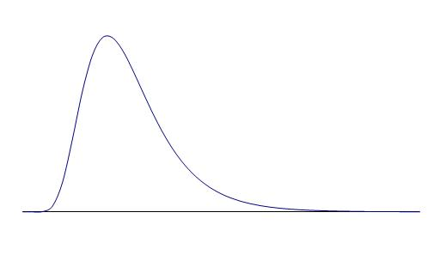
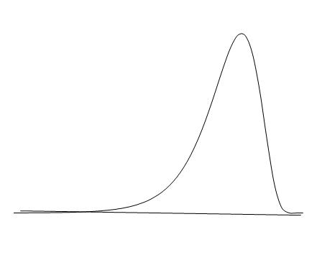
But the distribution of the daily return on an option is not normal
(See Figure 20.4, page 444)
Positive Gamma
Negative Gamma

Slide 37
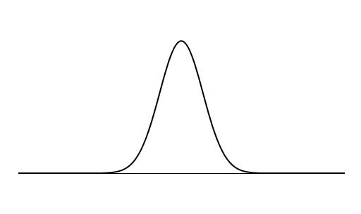
Translation of Asset Price Change to Price Change for Long Call (Figure 20.5, page 445)
Long Call
Asset Price

Slide 38
Translation of Asset Price Change to Price Change for Short Call (Figure 20.6, page 445)
Asset Price
Short Call

Slide 39
EWMA Model (equation 20.11, page 447)
In an exponentially weighted moving average model, the weights assigned to observations on daily returns decline exponentially as we move back through time
This leads to
Where σ_{n} is the volatility on day n and u_{n} is the observed return on day n

Slide 40
Attractions of EWMA
Relatively little data needs to be stored
We need only remember the current estimate of the variance rate and the most recent observation on the market variable
Tracks volatility changes
λ = 0.94 is a popular choice for daily volatility forecasting

Slide 41
Correlations
Define u_{i}=(U_{i}-U_{i-1})/U_{i-1} and v_{i}=(V_{i}-V_{i-1})/V_{i-1}
Also
σ_{u,n}: daily vol of U calculated on day n-1
σ_{v,n}: daily vol of V calculated on day n-1
cov_{n}: covariance calculated on day n-1
cov_{n} = ρ_{n} σ_{u,n} σ_{v,n}
where ρ_{n} is the correlation between U and V

Slide 42
Correlations continued
(equation 20.13, page 449)
Using the EWMA
cov_{n} = λcov_{n-1}+(1-λ)u_{n-1}v_{n-1}

Slide 43
Model Building vs Historical Simulation Approaches
Model building approach has the disadvantage that it assumes that market variables have a multivariate normal distribution
Historical simulation is computationally slower and cannot easily incorporate volatility updating schemes

Slide 44
Impact on Four-Index Example
Correlation and volatility estimates increase so that there is a big increase in VaR and ES estimates
See pages 450-451.

Slide 45
Back-Testing
Tests how well VaR estimates would have performed in the past
Asks the questions:
  How often was the loss greater than the VaR level
  How often was the loss expected to be greater than the VaR level

